Slide 1
Parents’ Meeting
Introduction to Read Write Inc.
Notes:
Approximately 20 minutes is needed for this session.
Notes are provided to help you lead the presentation.
Notes in italics are for your attention only.
This bitesize parent session is designed as an introduction to Read Write Inc when you first implement the programme in your school and for parents of new YR children each September.
Use the other bitesize parent PPTs throughout the year to discuss and practise how they can help their child at home based on the child’s group.
Notes are provided to help you lead the presentation.
Notes in italics are for your attention only.
Provide copies of ‘Reading at Home Booklet 1 or 2’ from Oxford Owl.
Booklet 1 is sound groups and Ditty/ Red Groups and Booklet 2 for Green – Grey Storybooks.

Slide 2
Reading changes everything
Teach a child to read and keep that child reading and we will change everything.
And I mean everything.
Jeanette Winterson
Notes:
Read quote.
This is what we do in our school.
Research shows that children who learn to read quickly go on to succeed in school and in life.
Today I want to help you understand how your child is learning to read with phonics – specifically ‘Read Write Inc.’ Phonics.

Slide 3
Read Write Inc. Phonics and Fresh Start
Children learning to read in YR– Y2
Older children who need to ‘catch up’
Taught in groups based on their stage of reading and the sounds they need to know
Notes:
Who Is Read Write Inc Phonics for?
(Click) Phonics is for children in Reception, Y1 and Y2 who are learning to read.
Phonics is also for children in Y3 and Y4 who haven’t met the KS1 reading expectations. They need to catch up.
Each half-term, we assess and group our children based on their stage of reading not age of reading. ‘The fluency and understanding form a big part of this aspect as well. We need to children to be reading at a significant pace 90wpm (show video if possible). This means all children practise reading at the right level.
Reception group across their own year group. Y1 – Y3 are grouped with children learning the same sounds and with similar decoding skills.

Slide 4
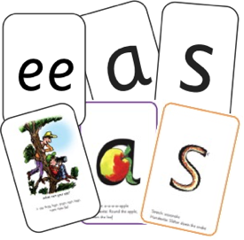
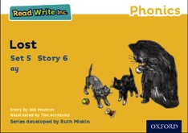


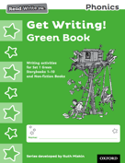

Read Write Inc. Phonics daily lessons
Notes:
What Read Write Inc. does is simple - we teach sounds (click), children practise reading and spelling words containing these sounds (click), then we give children decodable books (click) containing sounds and words they can read.
They read each Storybook three times at school and again with you at home.
On each reading, children’s fluency increases and the more they can focus on what the story is about.
Children also learn to spell the words they have been reading and develop their ideas into sentences so that they can write about the Storybooks they read.
Alongside this we read stories to children: (click) stories they cannot yet read for themselves
Our aim is that children have a good understanding of how to read, and are off the RWI programme by the end of autumn term in year 2. Then children will be able to access any age expected book and read it for themselves.

Slide 5
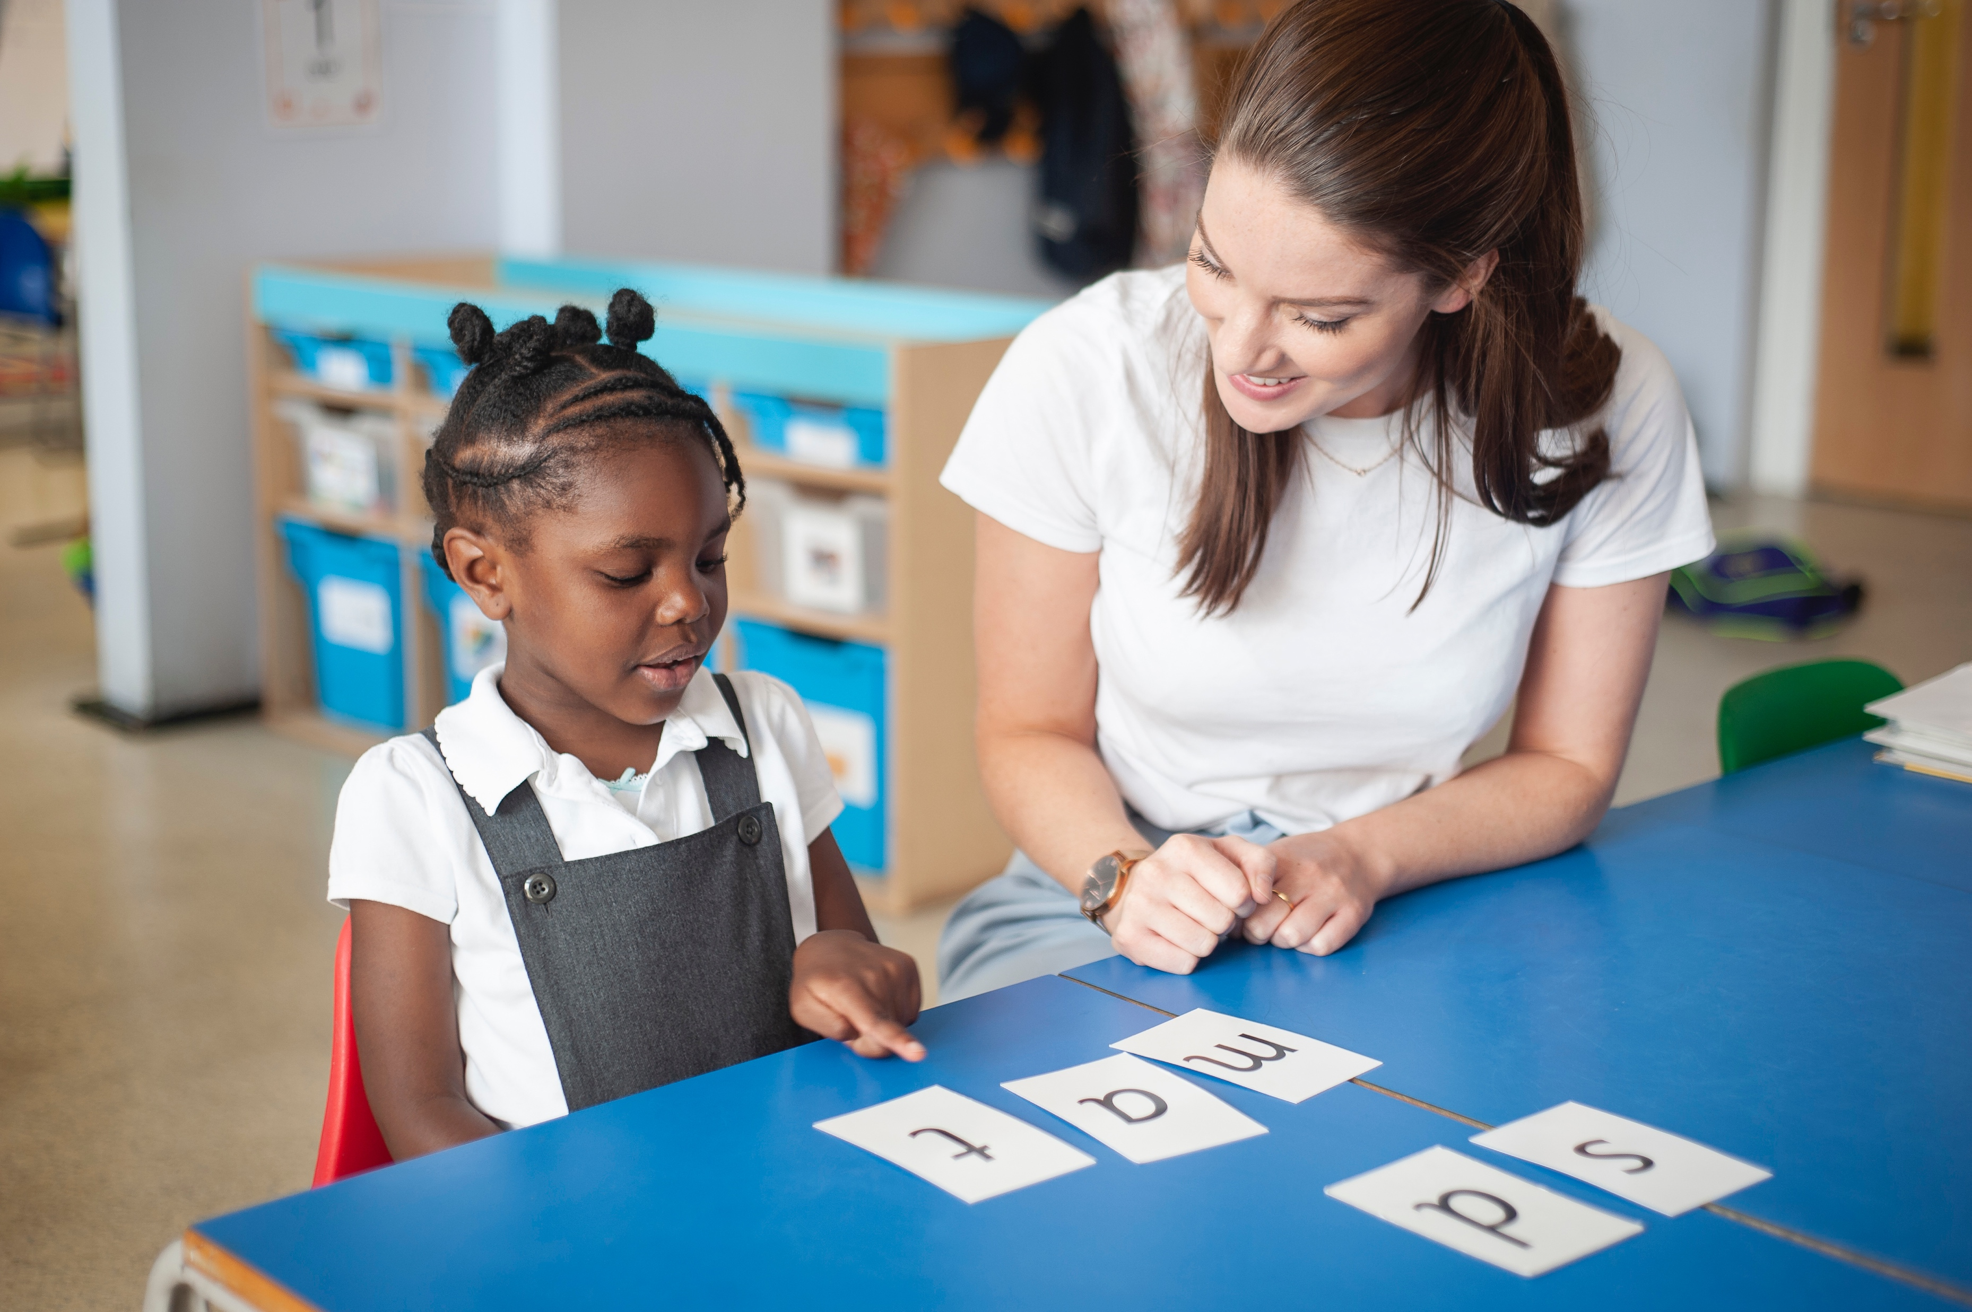
One-to-one tutoring – ‘keep up, not catch up!’
Notes:
We want to make sure every child learns to read in our school.
Some children need extra practice when learning to read so we teach these children one-to-one for ten minutes every day – on top of their group lesson.
We aim for as many pupils as possible to ‘keep up’ from the beginning but the one to one sessions give added support to enable any who need to ‘catch up’

Slide 6
What is phonics?
Sounds
Graphemes
Notes:
All words are made up of individual sounds. These sounds are merged together to form words.
e.g. in ‘mat’ we have the sounds ‘m’, ‘a’, ‘t’, ship – ‘sh’, ‘i’, ‘p’.
Click A grapheme is another name for the letters we use to write the sound. The spelling of that sound on the page. Special Friends.
Show some green words
Mat
Ship
Night

Slide 7
English alphabetic code
44 sounds
26 letters
Over 150+ graphemes (letter combinations)
One of the most complex alphabetic codes in the world.
Notes:
We use 44 sounds to make all the words in the English language.
This means we’ve got a problem.
We’ve got 44 sounds and only 26 letters.
The 26 letters work singly, in pairs and sometimes in threes to represent one sound.
We have to group letters together to write some sounds e.g. ‘igh’, ‘air’.
In English we have more than 150 ways to represent 44 sounds, using the 26 letters in the alphabet.
Click
This makes our language one of the most complex in the world!

Slide 8
Speed Sounds Set 1 and Set 2
Notes:
Using RWI, we make learning to read easy for children because we start by teaching them just one way of reading and writing every sound. Here they are on the Simple Speed Sounds chart we use in class.
We teach Set 1 sounds first - (sounds as far as a e i o u).
Children need to know sounds – not letter names – to read words.

Slide 9
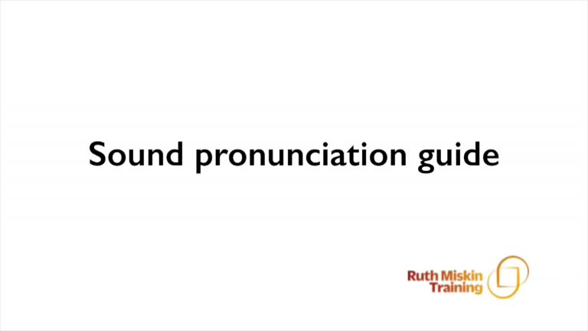
Pure Sounds (ruthmiskin.com)
Notes:
We teach using pure sounds.
We pronounce the sounds clearly, using pure sounds (‘m’ not’ muh’, ’s’ not ‘suh’, etc.) so that your child will be able to blend the sounds together to make words more easily.
You can watch this film of little Sylvie on the Ruth Miskin website to practise using pure sounds. Play a little bit of the video.

Slide 10
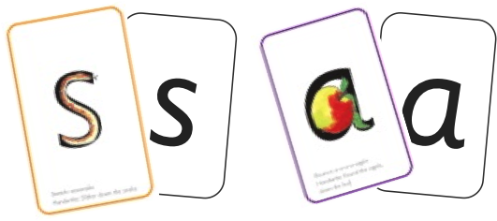
Sounds
Notes:
Alongside teaching children sounds, we teach them to blend sounds to read words e.g. s-a-t, sat.
We use Fred Talk to help children read.

Slide 11
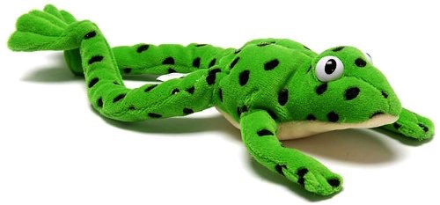
Fred
Notes:
Let me introduce you to Fred.
Fred can only speak in sounds. He says d-o-g, h-a-t etc.
Speaking like Fred helps children to understand that words are made up of sounds.
Fred helps children practise blending sounds together because he needs the children to say the words for him. Fred says d-o-g, children tell him the word is dog.
This is how we quickly teach all of our children to blend.

Slide 12
Sounds + blending = reading
+
Notes:
Alongside teaching children sounds, we teach them to blend sounds to read words e.g. s-a-t, sat.
We use Fred Talk to help children read.

Slide 13

Teach spelling using Fred Fingers
Notes:
We use Fred Fingers to help children sound out words to spell easily.
It means they do not have to memorise lists of spelling words.
It is a tool so they will be able to spell any word.
You might hear your child talking about fred fingers. That is how we teach them to split the word in to sounds.

Slide 14
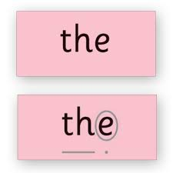
Spelling red words
Notes:
We use Fred Fingers to help children sound out words to spell easily.
It means they do not have to memorise lists of spelling words.
It is a tool so they will be able to spell any word.
You might hear your child talking about fred fingers. That is how we teach them to split the word in to sounds.

Slide 15

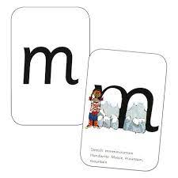
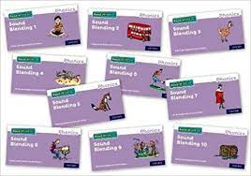
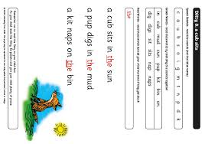




What will my children bring home?
+
+
+
Notes:
In your child’s book bag, they will bring home:
the Storybook they have read in class to practise reading what they can already read.
- if applicable a Book Bag Book. They have guidance inside just for you as parents., They are matched to the books children read in school so provide practice of the same sounds – extra practice at the right level for your child. They include many of the same reading activities that we use in class.
A picture book to share with you which has already been read to them so they care about it. This may be a reading challenge or favourite 5. You can read the story to them or they can retell the story by looking at the pictures. They are not expected to read the story themselves.
We make sure that every book that goes into your child’s book bag is a well-loved book – one they know already and want to read again and again.

Slide 16
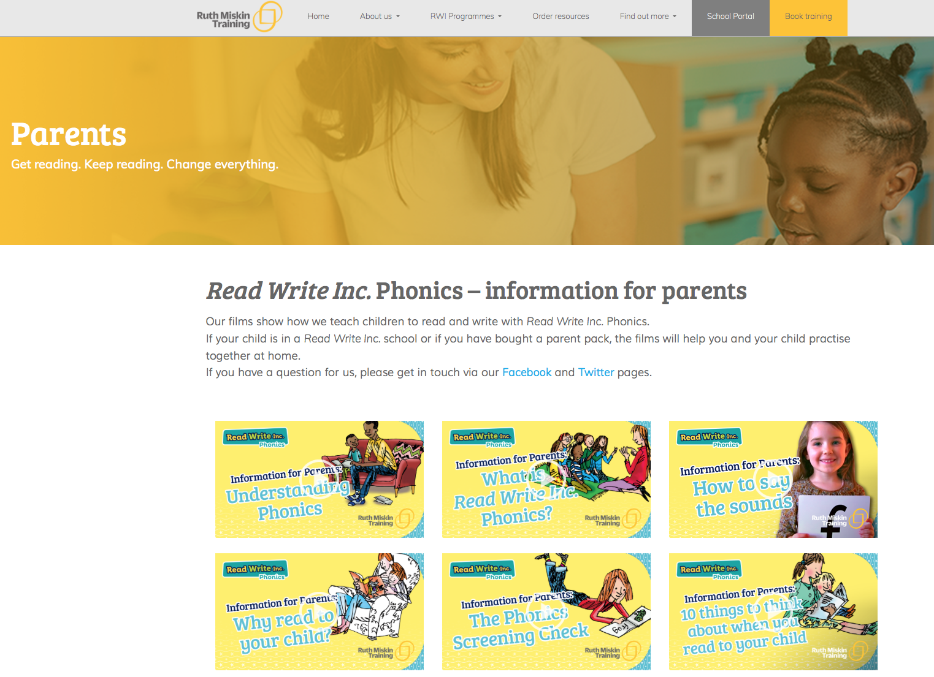
Free Video Tutorials (ruthmiskin.com)
Notes:
Watch video tutorials on the Ruth Miskin website to help you to understand more about Phonics, Read Write Inc. and how to practise reading and writing with your child at home.

Slide 17
What can I do?
Use pure sounds, not letter names
Use Fred Talk to read and spell words
Practise reading with your child every day (sounds, sound blending book, ditty sheet)
Read stories to your child every day
Notes:
We will run regular bitesize meetings to look at each of these in more detail.
Provide copies of ‘Reading at Home Booklet 1 or 2’ from Oxford Owl.
Booklet 1 is sound groups and Ditty/ Red Groups and Booklet 2 for Green – Grey Storybooks.

Slide 18
Online resources available
Ruth Miskin Parents’ Page:
http://www.ruthmiskin.com/en/parents/
Ruth Miskin Facebook:
https://www.facebook.com/miskin.education
Free e-books for home reading:
http://www.oxfordowl.co.uk/Reading/

Slide 19


Slide 20
Any other questions
Q&A

Slide 21
Reading feeds the imagination, it expands
horizons and offers new and exciting ways of
seeing and making sense of our lives and of
the world around us.
Michael Morpurgo
Notes:
Remember that all parents have the power to change outcomes for their children.

